Slide 1











Solving public health problems through innovative scientific research
www.icddrb.org
Research
Data
Health
Md. Yunus Abedin
Data Management Assistant Nutrition Research Division

Slide 2



Presentation outline
1
What is data and information
2
Data and its classification

Slide 3


Slide 4






In a research
Research is a systematic investigation to establish facts and reach new conclusions
Data collection is the foundation of any scientific research
Understanding data types helps in choosing appropriate analysis methods

Slide 5


Slide 6





So what you collect?
What type of data do researchers collect?
Primary Data
Secondary Data
Mixed Data
Original first-hand information collected specifically for your research
Methods Benefits
Existing data previously collected and published by others
Sources Benefits
Combination of qualitative and quantitative data for comprehensive analysis
Methods Benefits
Surveys, Interviews, Observations, Experiments
Government agencies, Academic journals, Research institutions, International organizations
Sequential designs, Convergent designs, Embedded designs, Transformative designs

Slide 7




What Is SCIENTIFIC METHOD?
Short Review on Epidemiology
A systematic process for building knowledge through observation, experimentation, and testing of hypotheses
1
2
3
Observation
Hypothesis
Prediction
Identify a phenomenon or question to investigate
Form a testable explanation for the observation
Make specific predictions based on the hypothesis
4
5
6
Experimentation
Analysis
Conclusion
Design and conduct experiments to test predictions
Collect and analyze data from experiments
Determine if hypothesis is supported or rejected

Slide 8







Primary data
Definition
Original first-hand information
You collect it for your own research Specific to your needs
More insights in any specific issue
Collection Procedure
Interviews
Observation
Case Studies
Questionnaires

Slide 9
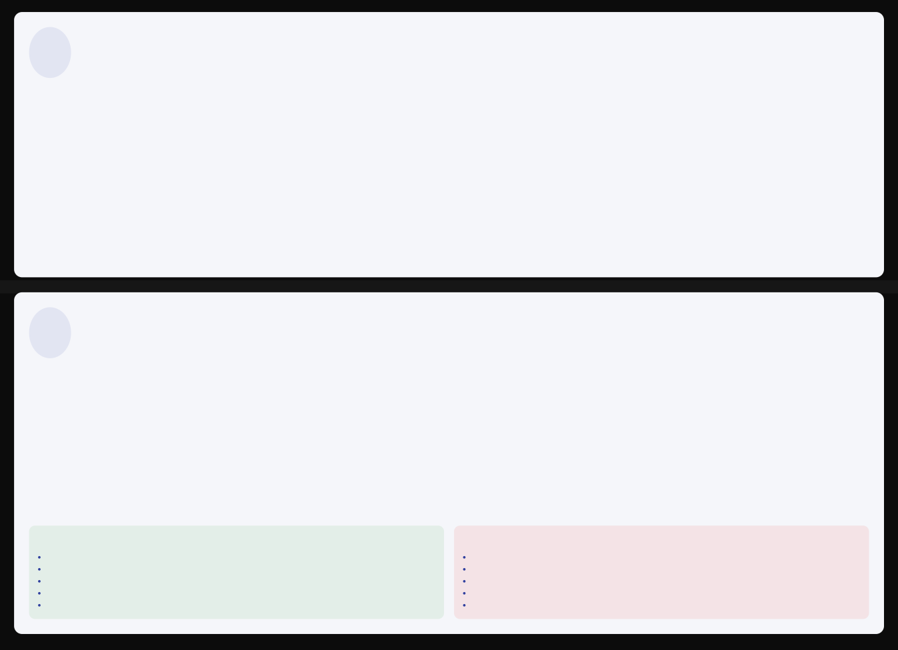










Secondary data
Definition
Someone collected and published previously and you are using
(We re-use) existing data Saves Time
Saves Money/Saves Man Hours
Collection Procedure
Government Agencies
e.g. BBS
Academic Journals
Peer-reviewed publications
Research Institutions
University research centers
International Organizations
e.g. World Bank, WHO
Advantages
Disadvantages
Cost-effective Time-efficient Large sample sizes
Longitudinal data availability Expert collection methods
May not fit specific research needs Potential data quality issues Limited control over variables
May be outdated
Potential bias in original collection

Slide 10


















Qualitative data
Definition
Data that describes qualities, characteristics, or attributes rather than numbers. It answers questions like "What? Why? How?" instead of "How many?" or "How much?" Usually expressed in words, images, or symbols rather than numeric values.
Qualitative
Quantitative
Collection Procedure
Examples
Focus groups
Interview transcripts
Social media comments
Interviews
Observations
Case studies
Photos
Videos
Open
Smell, Emotion, Beauty
Document analysis
ended survey response

Slide 11











Quantitative data
Definition
Quantitative data is numeric information that can be measured, counted, and analyzed statistically. It answers questions like "How many?", "How much?" or "How often?"
Qualitative
Quantitative
Data collection procedure
Examples
Surveys with close- ended questions
Experiments (scientific measurements)
Age
Height
Weight
Exam Scores
Observations with numeric recording
Databases & official statistics
Income
Number of customers

Slide 12










Discrete data
Definition
Countable, separate, and distinct values
Represents whole numbers
No fraction or decimals
Gap exist between values
Examples
Number of children in a family
Number of cars
Number of students
Number of rice in a pot
Shoe size
Population count
1
2
3
4
5

Slide 13

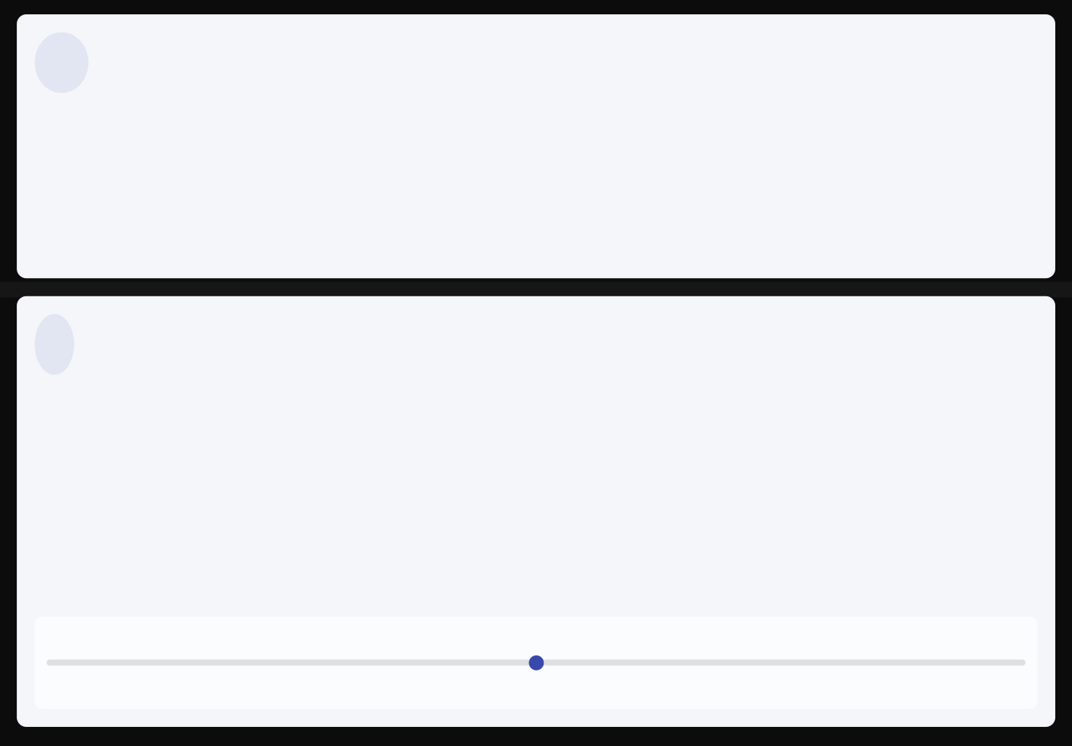










Continuous data
Definition
Measurable through measurement rather than counting
Infinite possible values within a range
Decimals/fractions are possible
No gaps between values → continuous
Examples
Height of a person (170.2 cm)
Weight of a bag (12.75 kg)
Time taken to run a race (5.98 sec)
Temperature (36.6°C)
Distance between cities (325.4 km)
Volume of liquid (250.5 ml)
Interactive Slider - Demonstrating Infinite Values Within a Range
50.00

Slide 14










Discrete vs Continuous (Quick Comparison)
Discrete Data
Continuous Data
Countable values
Measurable values
Whole numbers only
Infinite possible values
No fractions or decimals
VS
Decimals/fractions possible
Gaps exist between values
No gaps between values
Finite or countably infinite
Continuous range of values
Healthcare
Business
Education
Healthcare Example: Discrete: Number of patients admitted (5, 10, 15) | Continuous: Patient temperature (36.6°C, 37.2°C, 38.5°C)

Slide 15










Scales of Measurement in Statistics
Nominal Data
Ordinal Data
Categories with no intrinsic order. Used for labeling variables without any quantitative value.
Statistical Measures
Can calculate Percentage or Proportion. The only measure of central tendency is Mode.
Categories with a specific order or rank. The intervals between values are not necessarily equal.
Statistical Measures
Can calculate Frequency and Mode. Since there's an order, we can also calculate Median.
Interval Data
Ratio Data
Ordered data with equal intervals but no true zero point. Differences are meaningful but ratios are not.
Statistical Measures
Can calculate Mean, Median, Mode, and Standard Deviation. Cannot form ratios.
Ordered data with equal intervals and a true zero point. Both differences and ratios are meaningful.
Statistical Measures
All possible statistical measures can be applied. Ratios are meaningful (e.g., 20kg is twice as heavy as 10kg).
Nominal Ordinal
Interval
Ratio

Slide 16







Other classification
Cross-sectional VS Time series VS Panel data
Cross-sectional Data
Structured VS Semi structured VS Unstructured Data
Structured Data
Collected at one point in time (e.g., survey in 2025)
Organized, fits into rows/columns (e.g., Excel spreadsheet)
Time Series Data
Collected over time (e.g., stock prices daily, rainfall monthly)
Unstructured Data
Free form, not easily organized (e.g., videos, emails, images)
Panel Data
Multiple subjects (individuals, firms, countries, etc.) over multiple time periods
Semi-structured Data
Mixed format (e.g., JSON, XML files)

Slide 17













Thank you
icddr,b thanks its core donors for their on-going support
contact@icddrb.org
www.icddrb.org
+880-2-12345678

Slide 18








Data Collection Methods
Surveys
Interviews
Observations
Structured questionnaires designed to gather specific information from respondents.
Direct conversations with participants to gather detailed insights and perspectives.
Systematic watching of behaviors and interactions in natural settings.
Experiments
Focus Groups
Existing Data
Controlled procedures that manipulate variables to establish cause-effect relationships.
Group discussions facilitated to explore collective views on specific topics.
Using previously collected information from various sources for new research.
Choosing the Right Data Collection Method
Define Objectives
Clarify research questions and what information you need
Consider Audience
Identify your target population and accessibility
Assess Resources
Evaluate time, budget, and expertise available
Evaluate Methods
Compare advantages and limitations of each approach
Select & Implement
Choose the most suitable method and execute properly

Slide 19










Data Analysis Techniques
Quantitative Data Analysis
Qualitative Data Analysis
Descriptive Statistics
Content Analysis
Summarizes and describes the basic features of data in a study.
Systematic analysis of text, images, or other communication materials.
Inferential Statistics
Thematic Analysis
Draws conclusions about populations based on sample data.
Identifying, analyzing, and reporting patterns within data.
Selecting Appropriate Analysis Techniques
Research Question
Define what you want to discover
Data Type
Identify quantitative or qualitative
Analysis Goal
Describe, explore, or explain
Select Technique
Choose appropriate method
Apply & Interpret
Execute analysis and draw conclusions

Slide 20








Data Visualization
Charts & Graphs
Tables
Infographics
Visual representations of data using bars, lines, or other graphical elements.
Structured arrangement of data in rows and columns for precise values.
Visual representations combining images, charts, and minimal text for quick understanding.
Visualization Selector Tool
Quantitative Data
Recommended Visualizations
Numerical data that can be measured and counted
Select a data type to see recommended visualization methods
Qualitative Data
Research Goal
Descriptive data that represents characteristics and attributes
Consider what you want to communicate: comparison, distribution, relationship, or composition
Discrete Data
Countable values with gaps between them

Slide 21













Data Quality and Validation
Accuracy
Completeness
Consistency
Degree to which data correctly represents real-world values.
Measure of presence or absence of required data attributes.
Uniformity of data across different datasets or systems.
Timeliness
Validity
Uniqueness
Availability of data when needed and how current it is.
Conformity of data to defined rules, formats, and standards.
Absence of duplicate records or redundant data elements.
Data Validation Process
Data Profiling
Data Quality Checklist
Examine data sources to understand structure, content, and quality issues
Data sources documented
Missing values identified
Validation Rules
Outliers detected
Data formats standardized
Define and implement rules to check data accuracy, completeness, and consistency
Duplicate records removed
Validation rules implemented
Data Cleaning
Identify and correct errors, inconsistencies, and missing values
Data quality metrics defined
Quality monitoring established
Monitoring
Continuously track data quality metrics and implement improvement processes

Slide 22












Ethical Considerations in Data Collection
Informed Consent
Privacy & Confidentiality
Data Security
Voluntary agreement to participate in research with full understanding of risks and benefits.
Protecting participants' personal information and ensuring data is not disclosed without permission.
Measures to protect data from unauthorized access, use, disclosure, disruption, or destruction.
Ethical Review Boards
Responsible Data Sharing
Cultural Sensitivity
Committees that review and monitor research involving human subjects to ensure ethical standards.
Ethical practices for sharing research data while respecting privacy and confidentiality.
Respecting cultural differences and values when conducting research across diverse populations.
Ethical Decision-Making Framework
1
Identify Ethical Issues
Recognize potential ethical concerns in data collection and management
Key Resources
Belmont Report, Declaration of Helsinki, CIOMS Guidelines, GDPR, HIPAA
2
Assess Risks & Benefits
Evaluate potential harms to participants against research benefits
Training
Consult Guidelines
Review relevant ethical codes, regulations, and best practices
CITI Program, NIH Protecting Human Research Participants, ethics certifications
3
Implement Safeguards
Develop and apply measures to protect participants and data
Tools
4
Data anonymization software, consent management systems, ethical decision trees

